Slide 1
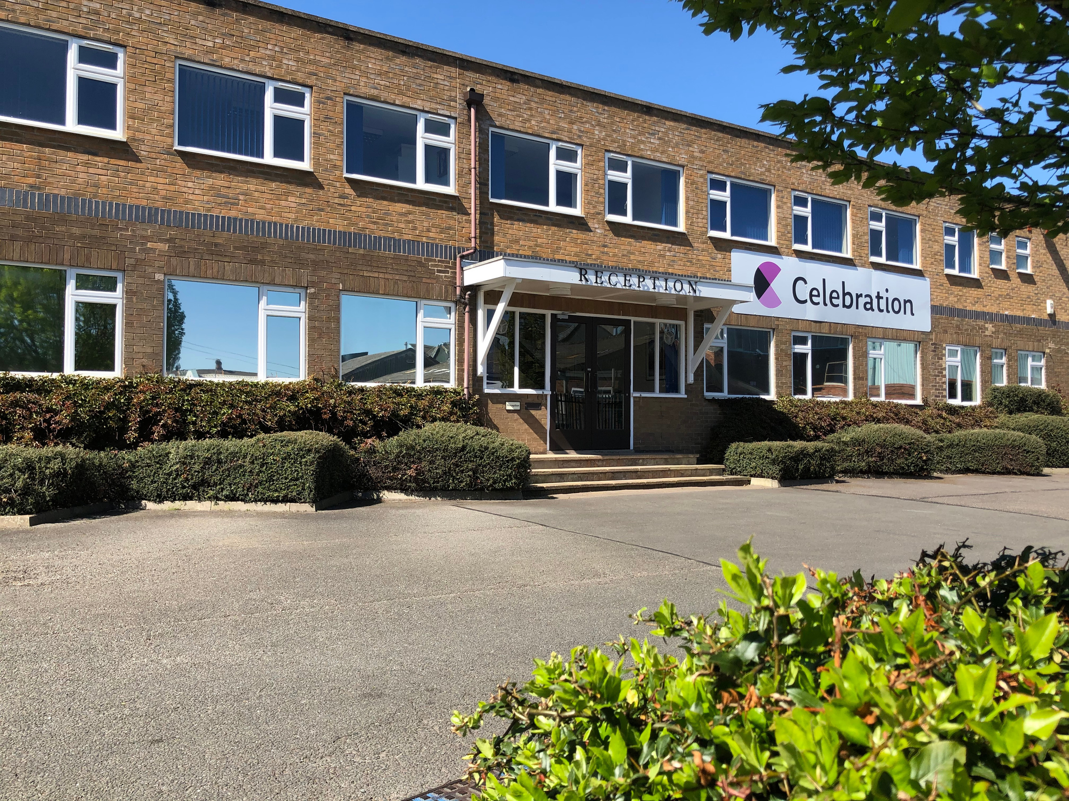
www.celebration.co.uk | sales@celebration.co.uk

Slide 2


EXTENDED PRODUCER RESPONSIBILITY (EPR)
A brief guide
Celebration History
Certification
But first we need to say a
DISCLAIMER
This guide is based on our interpretation of a very complex and confusing set of regulations and guidance which can, at times, seem somewhat contradictory. All readers are advised to do their own research to determine what actions their organisation may need to take. Additionally new aspects of the legislation will be introduced over the next few years that will increase its complexity. Celebration Packaging Limited assumes no responsibility or liability for any errors or omissions in this guide.
Our Brands
Latest Products and developments

Slide 3
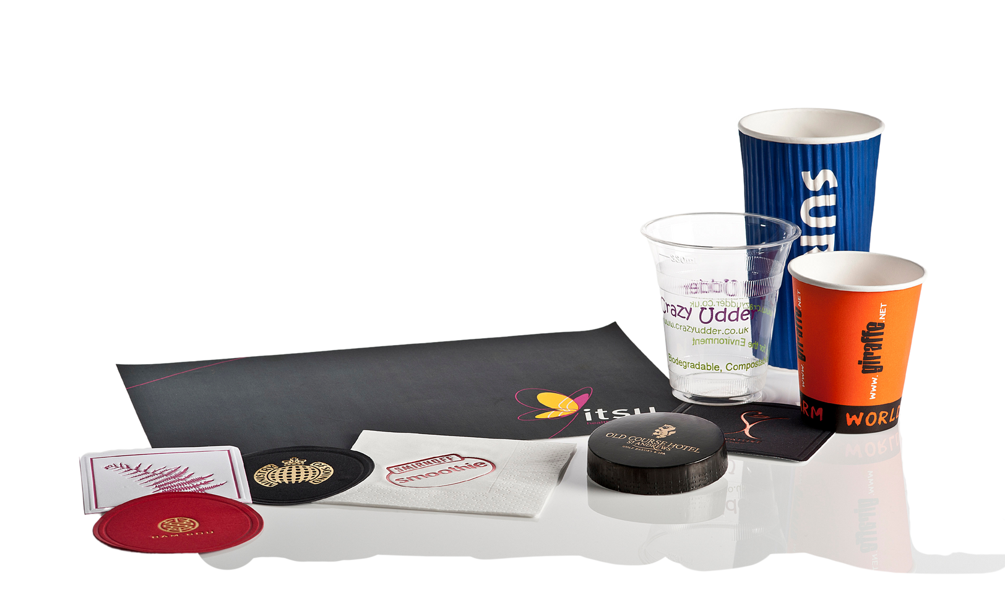
WHAT IS IT ?
It is a charge on nearly all packaging sold into the UK market. It does not apply to export sales.
It has been imposed by the Government and the money raised is to be passed to local councils to improve the collection, treatment and recycling of packaging.
WHEN DOES IT START ? – IT ALREADY HAS !
Charges started accruing on 1st January 2025.
Reporting requirements started in 2024.

Slide 4


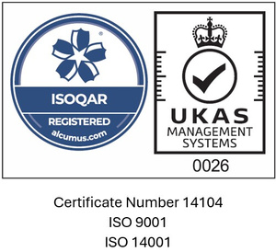

DO I NEED TO DO ANYTHING ?
You will need to register and collect packaging data if
You carry out one or more “Packaging Activity” (see next slide) AND
You turnover is over £1m AND
You import or supply more than 25 tonnes of packaging AND
You are not a charity.
If you need to register, you will be classified as a “large” organisation if your turnover is over £2m and more than 50 tonnes of packaging are handled by your organisation. In this case you will appear on the large producer list published by the Government but only once you have submitted your packaging data.

Slide 5
WHAT IS A “PACKAGING ACTIVITY”
Broadly speaking a “Packaging Activity” is
Placing goods into packaging (i.e. filling the packaging) OR
Importing products already in packaging OR
Importing or manufacturing empty packaging that is not ultimately supplied to a registered (large) business who fills that packaging OR
Supplying (or organising the supply of) goods in the UK under your own brand (the brand being for the goods not the packaging) OR
Hiring or loaning out reusable packaging OR
Operating a website that allows firms outside the UK to sell goods into the UK OR
Supplying filled packaging to the end user if it has not been accounted for by someone else in the supply chain

Slide 6
WHAT DOES ALL THIS MEAN ?
Celebration needs to collect and report packaging data as we are a “Large” organisation AND we import empty packaging that is filled by small and unregistered organisations (our cups / bowls / plates / clamshells etc are all packaging).
As a large organisation we also need to pay the charge as specified by the government.
However, we only need to pay the charge for those items that DO NOT end up being used (filled) by another large organisation.
To be able to pay over this charge to the Government we must collect it from our customers.
To do this we will shortly be issuing new pricing that will clearly show the impact of the charge on the items that you buy.
IF you believe that any items we sell to you are used (filled) by large organisations who give it to the final end user, OR you are yourselves a large organisation who uses the items, please let us know straight away. These large organisations need to register and pay the charge themselves so there is no need for us to alter your price. This will ensure the charge is not paid twice.

Slide 7
HOW IS THE CHARGE CALCULATED ?
The charge is based on the material the packaging is made of AND weight of the packaging.
The rates are expected to be –
Material | Price per tonne | Price per Kg
Aluminium | £435 | 43.5p
Fibre Based Composite ¹ | £455 | 45.5p
Glass | £240 | 24.0p
Paper or board (including bagasse) | £215 | 21.5p
Plastic (including bio plastics) | £485 | 48.5p
Steel | £305 | 30.5p
Wood | £320 | 32.0p
Other² | £280 | 28.0p
Fibre Based Composite is any material where the main material is paperboard fibre (made from wood, bamboo or other fibres) and which is then laminated with a plastic layer (which includes water-based coatings). For instance, a hot drink cup is made from a Fibre Based Composite material.
Other includes bamboo, ceramic, copper, cork, hemp, rubber, silicone etc.

Slide 8
WHAT SHOULD I DO NOW ?
If you believe you need to register and haven’t done so already you should register on the Government website.
You may want to consider using the services of a compliance agency (you will almost certainly need one !)
To avoid any double paying let us know which items, and how many, you sell to large organisations that are filling the packaging and giving it to the end user.

Slide 9
USEFUL LINKS
Government Introduction
https://www.gov.uk/guidance/extended-producer-responsibility-for-packaging-who-is-affected-and-what-to-do
And also
https://npwd.environment-agency.gov.uk/public/Guidance.aspx?CategoryId=41fc1dbb-47a2-47fd-bb82-4938d83729e0&ReturnUrl=%2Fpublic%2FNewsAndGuidance.aspx
There is a lot on this page, for the latest information look for
EPR Regulator Agreed Positions and Technical Interpretations Version 5.1
Fees
https://www.gov.uk/government/publications/epr-for-packaging-updated-illustrative-base-fees-december-2024/extended-producer-responsibility-for-packaging-illustrative-base-fees-december-2024

Slide 10
USEFUL LINKS (continued)
List of Large Organisations
The is updated regularly by the DEFRA
https://report-packaging-data.defra.gov.uk/large-producers
Compliance Schemes
There are many compliance schemes most of which offer useful information on EPR as well as helping with data submissions. A full list of these schemes can be found on the Environment Agency website
https://npwd.environment-agency.gov.uk/PublicRegisterSchemes.aspx
A general internet search for “Extended Producer Responsibility” should also provide a lot of useful information.

